Slide 1
Damage Resistant Solid Emulsion Metamaterials
Ben Thorne
Cooper Wang
Weitz Group

Slide 2
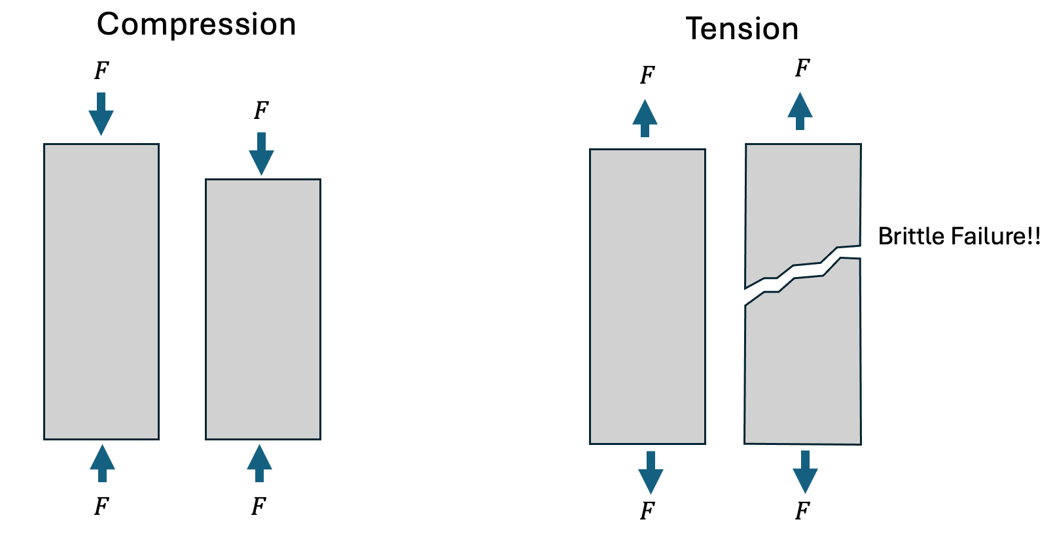
Concrete is strong when compressed, weak when stretched

Slide 3
The idea – high volume fraction granular materials
Keeps compressive strength
No catastrophic cracking
Friction in interfaces dissipates energy – reduces damage
Stretching is uniform

Slide 4
The idea – high volume fraction granular materials
Keeps strong compressive strength
No catastrophic cracking
Friction in interfaces dissipates energy – reduces damage
Steel reinforcements adds tensile strength

Slide 5

Blocks are individually machined and assembled
Expensive to manufacture
Expensive to assemble
Difficult to reinforce

Slide 6
The idea – compressed frozen emulsions
Freeze/cure – liquid to solid transition
Fill pores with elastomer
Cheap to manufacture, pumpable
Conforms to shape of container (can make any shaped mold).
Easy to reinforce - conforms to steel reinforcements.

Slide 7
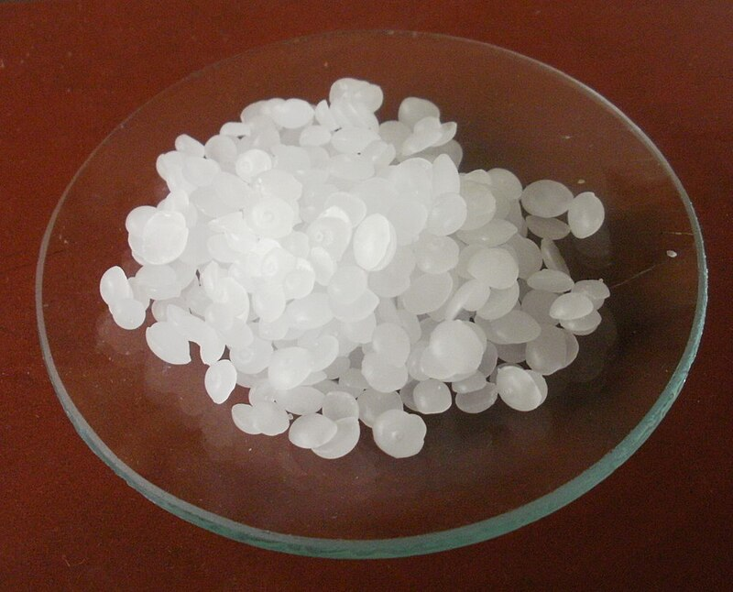
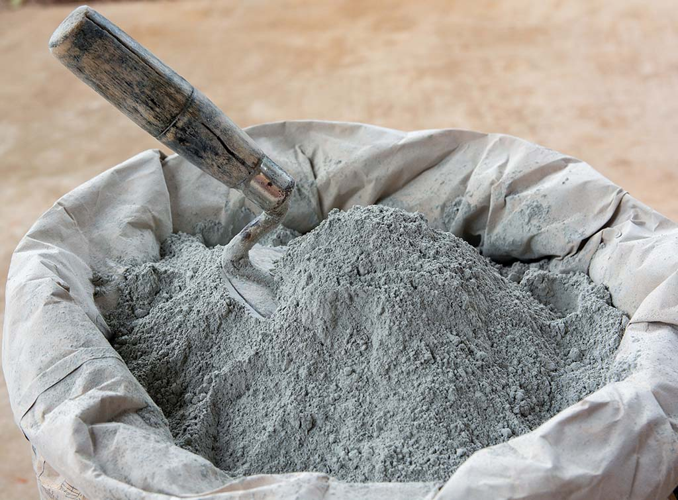

Experimental Strategy
Model System: Wax emulsion in water
Practical System: Cement emulsion in PDMS

Slide 8
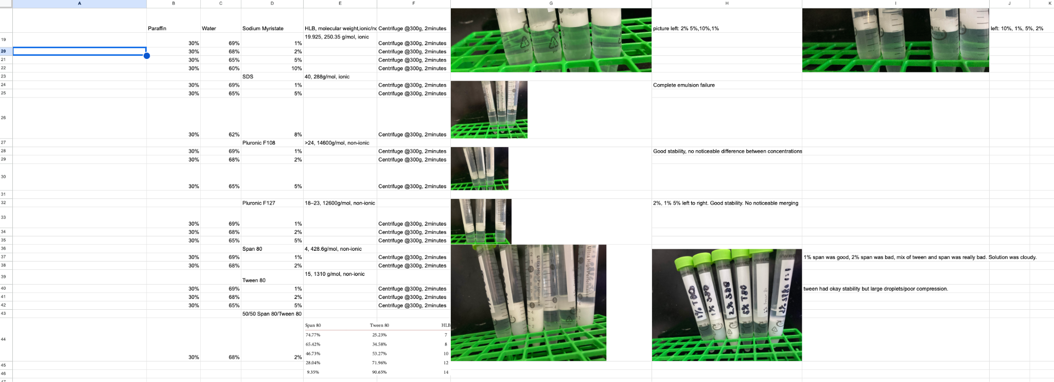
Model System - Wax Emulsions
Varying surfactant to get stable wax emulsions

Slide 9
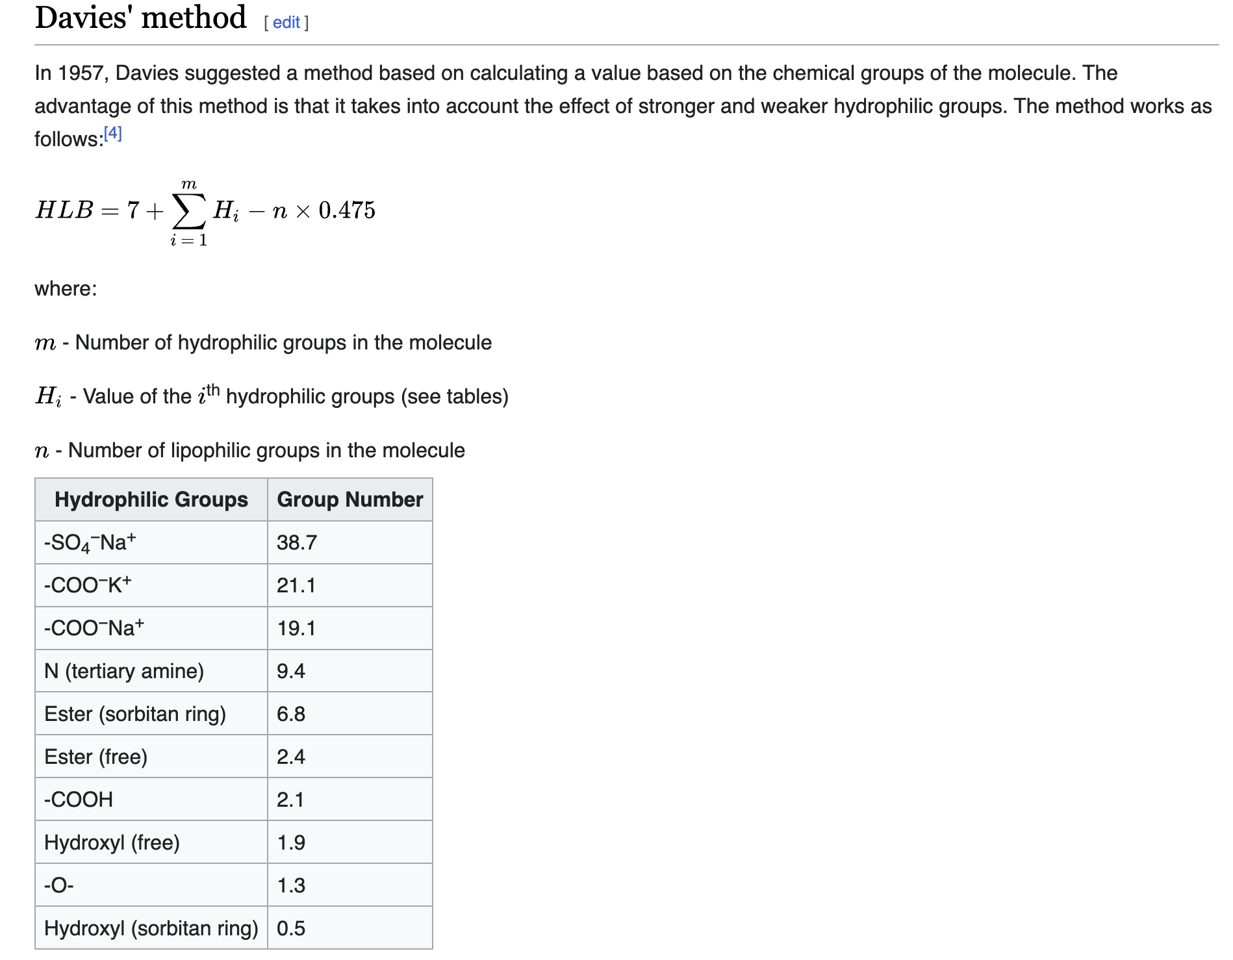
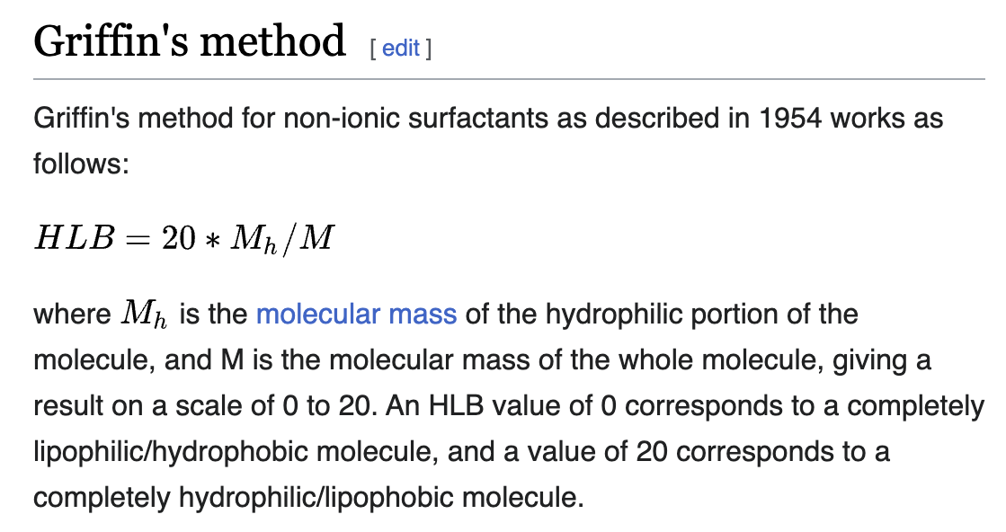
Quick detour: What is HLB?

Slide 10
What does success look like?
F
F
In tension, the composite should have the same properties (modulus, yield stress, etc.) as the matrix
In compression, the composite should have the same properties (modulus, yield stress, etc.) as the particles
F
F

Slide 11
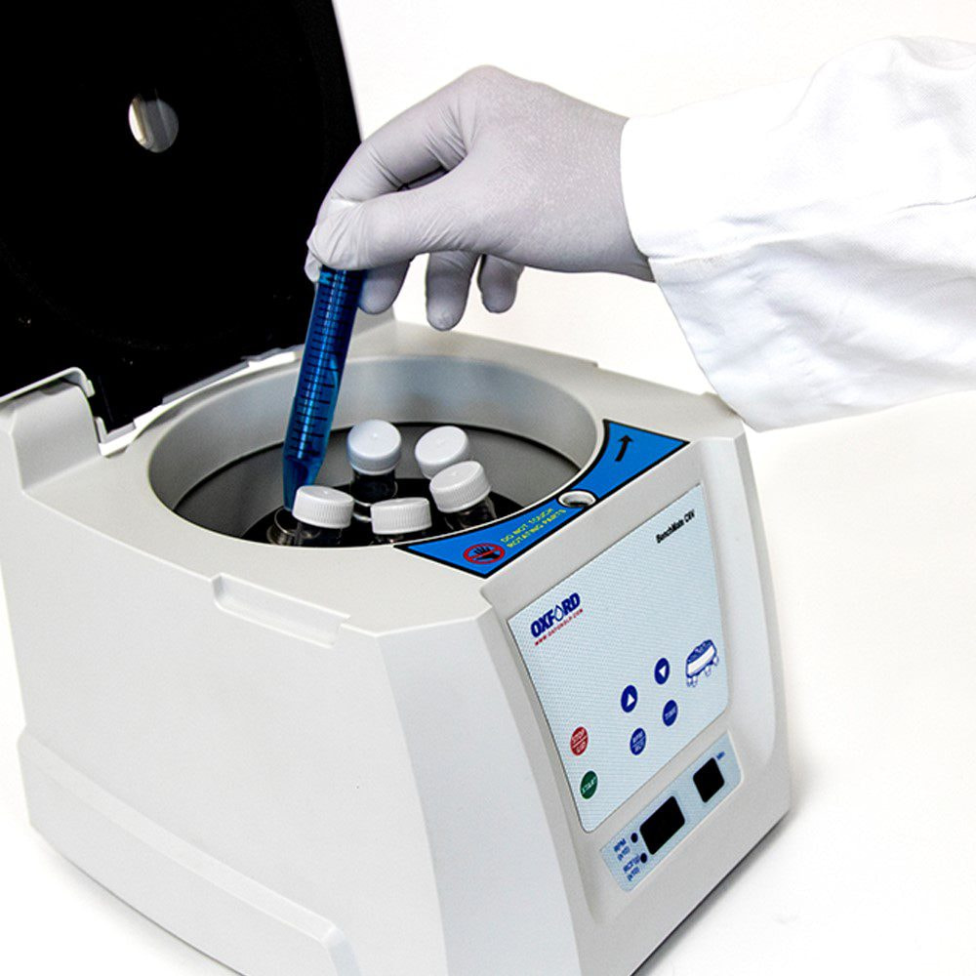
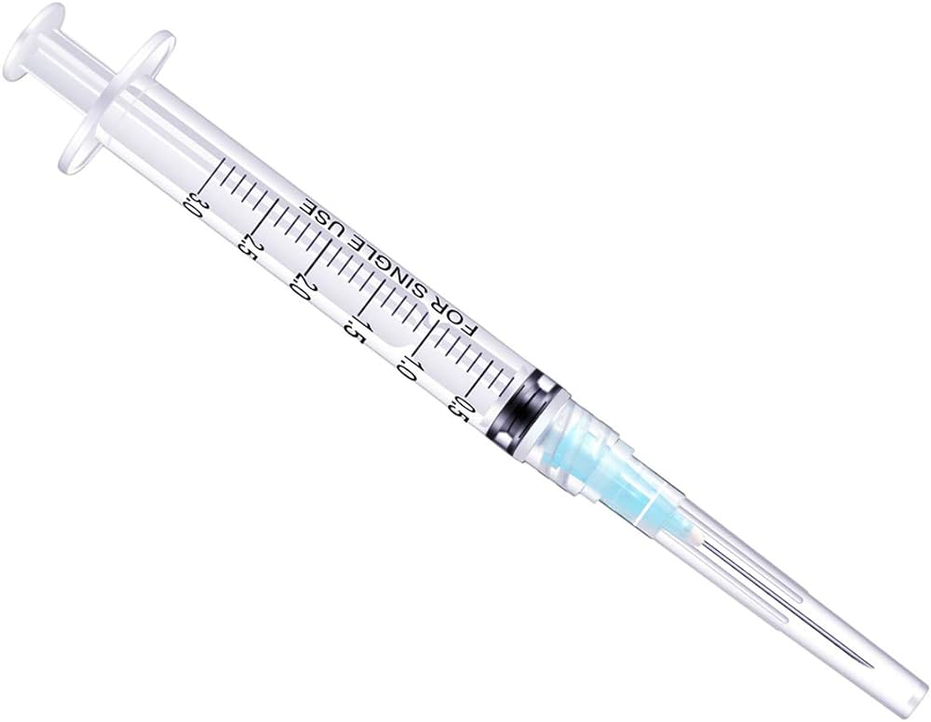

Method

Slide 12
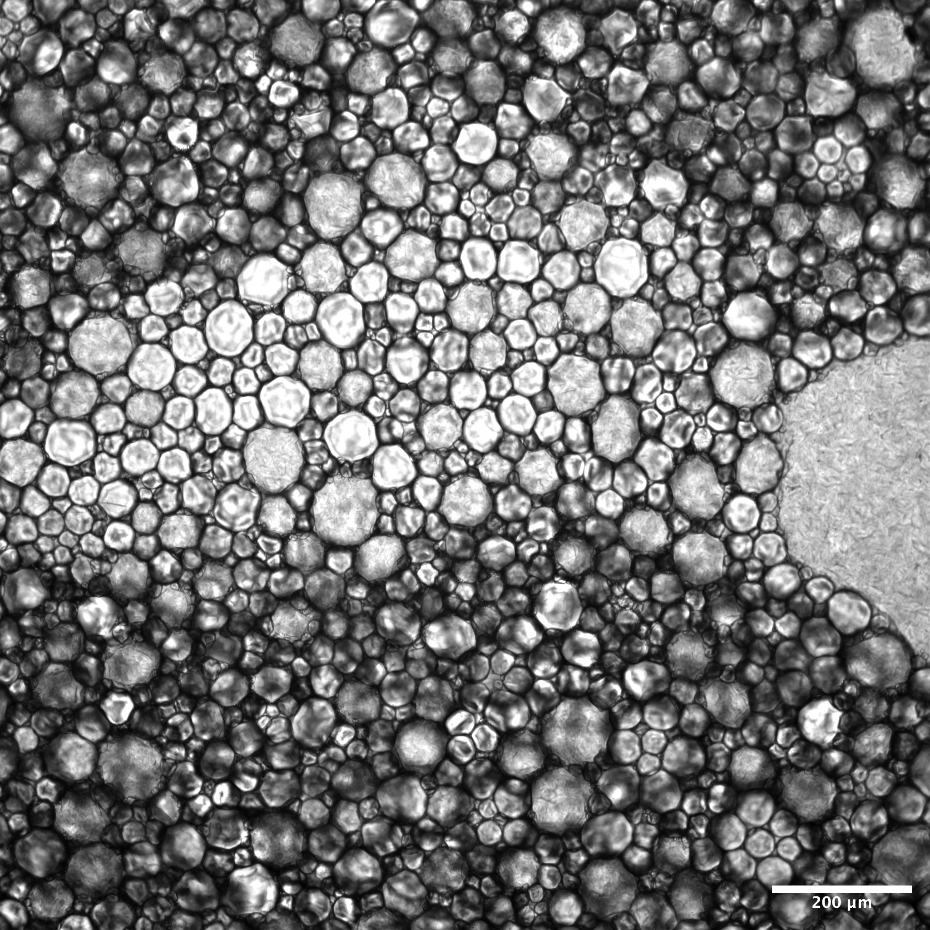
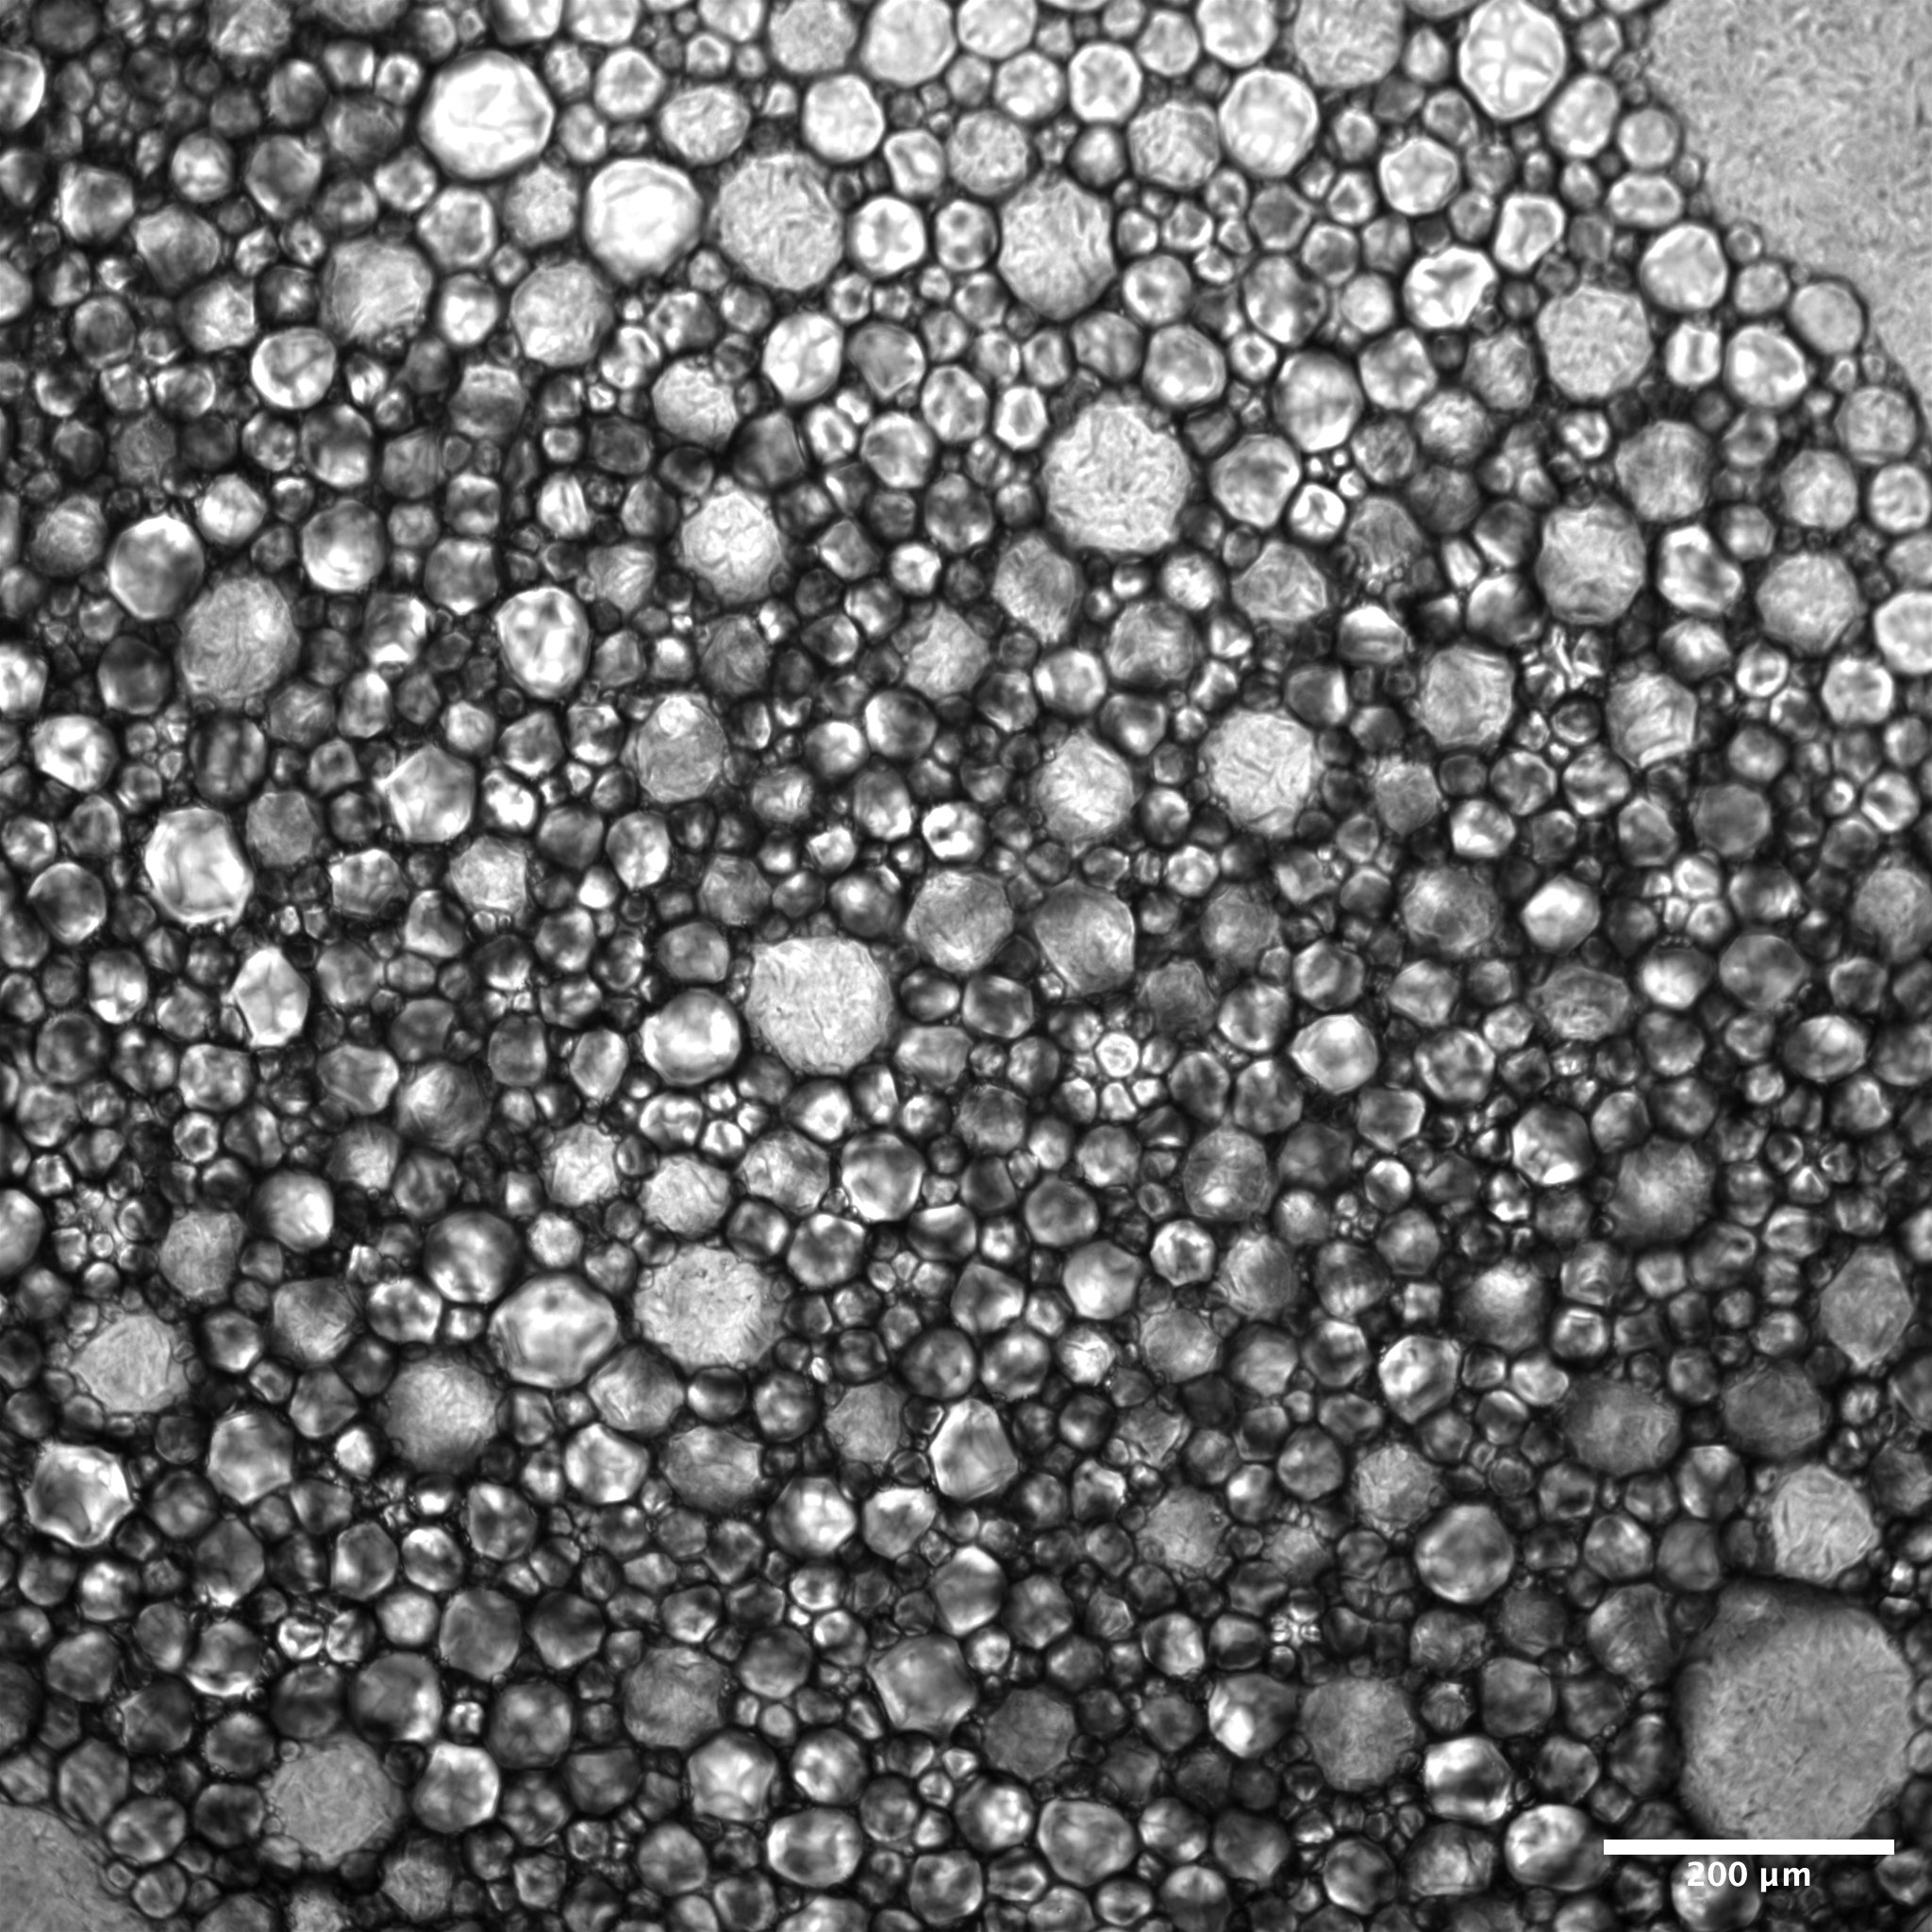
Emulsion and Compression
1% pluronic F127, ~93% paraffin wax, ~6% water

Slide 13
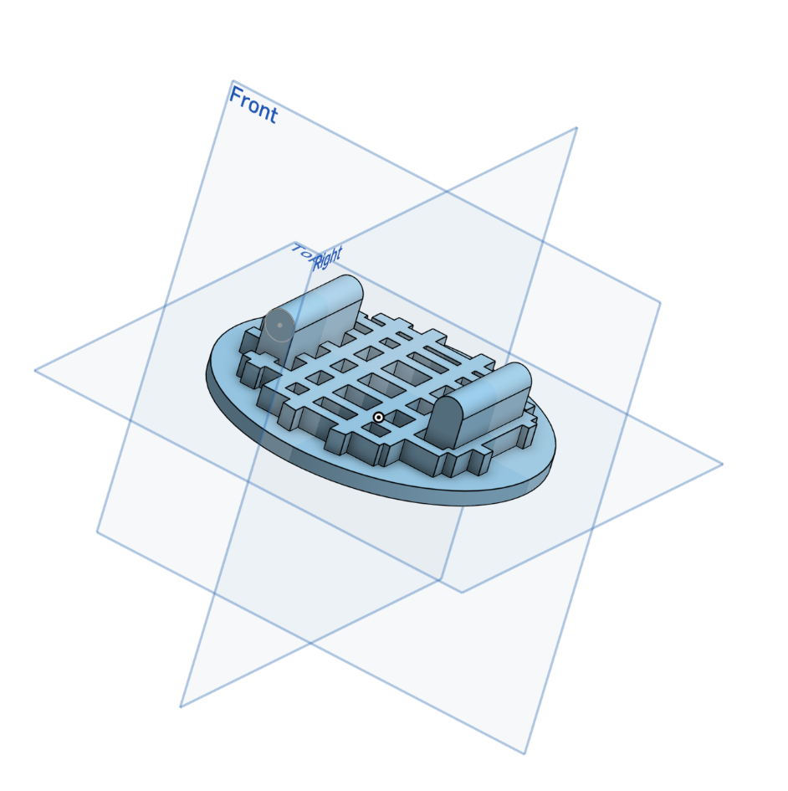
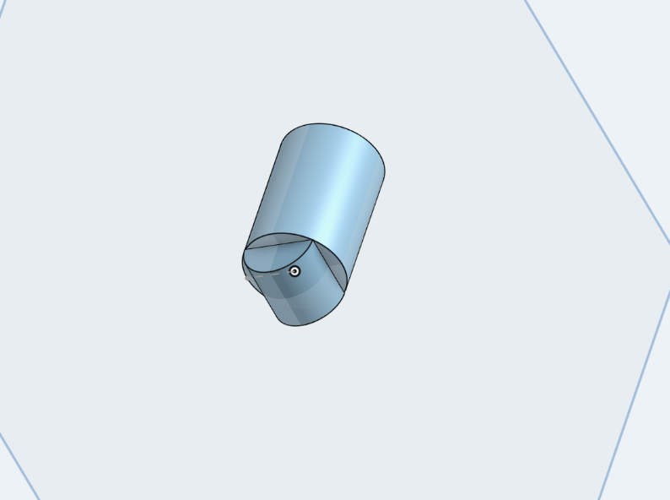
Bending test design

Slide 14
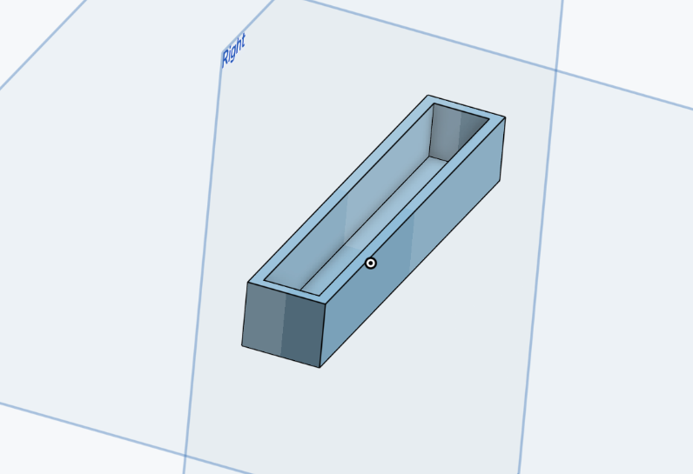
Mold

Slide 15

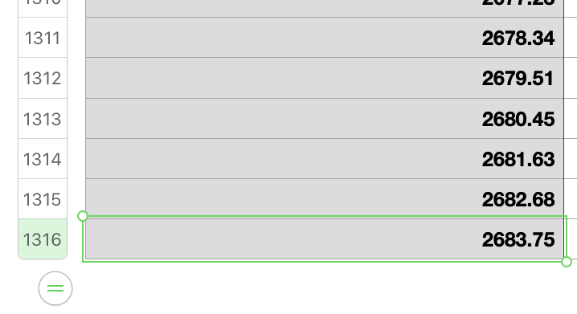
Data

Slide 16
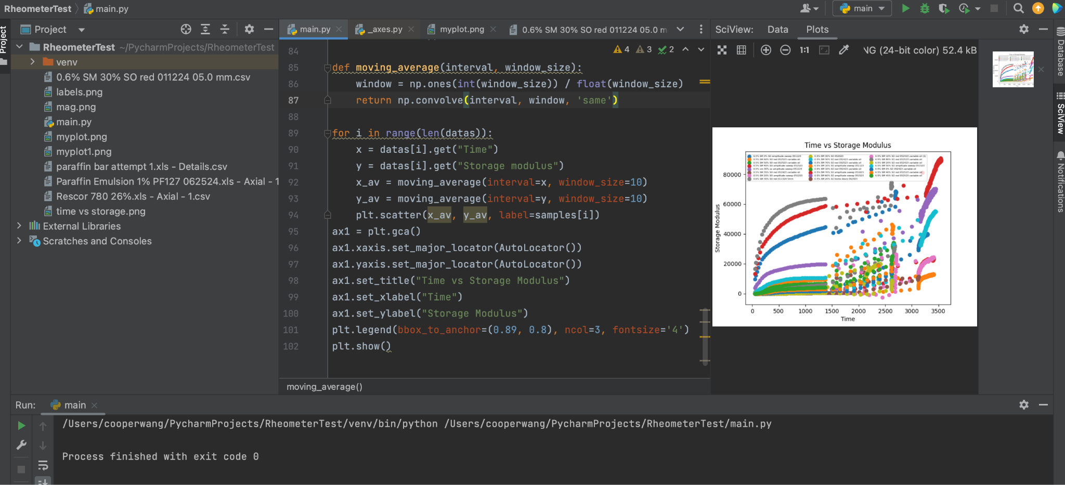
Data analysis

Slide 17
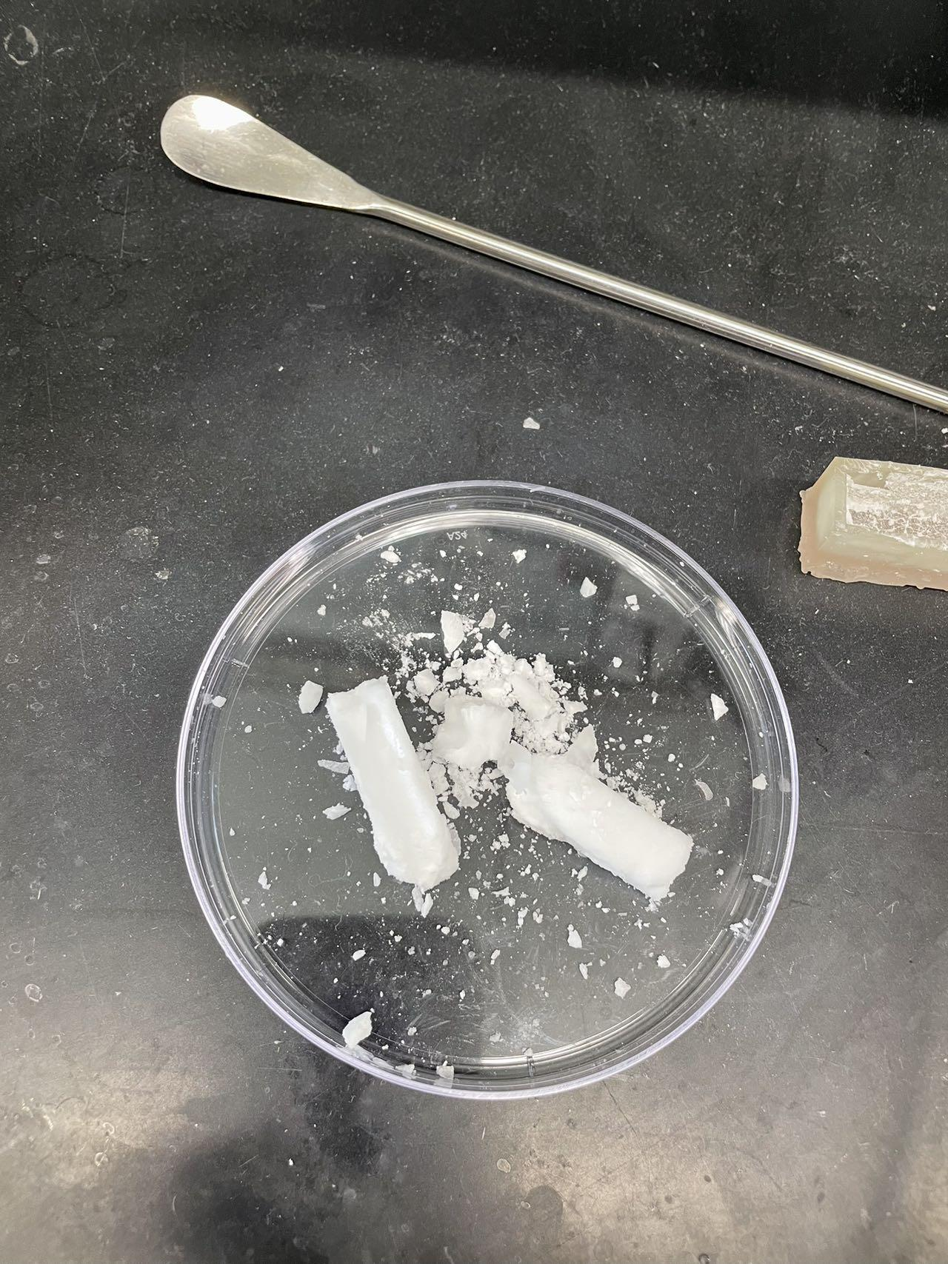
Problem
Wax is wax
The mold spray makes it worse

Slide 18
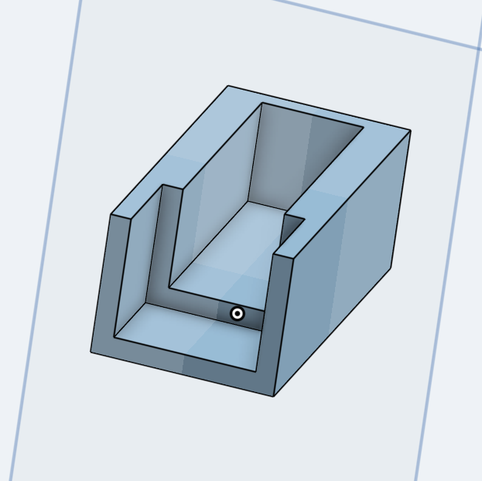
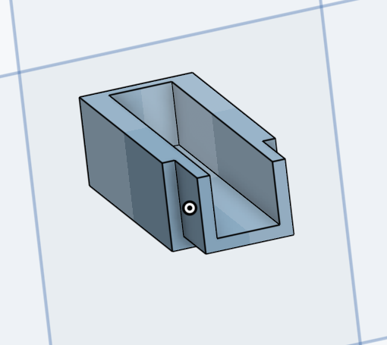
Improved design V2

Slide 19
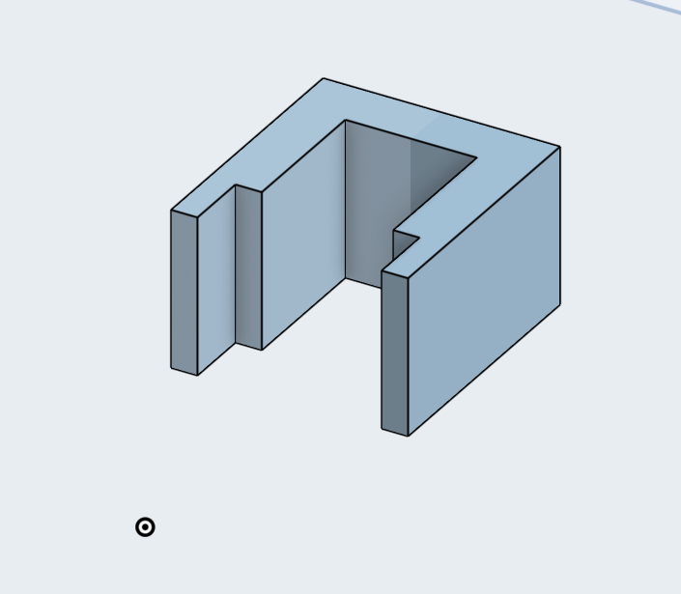
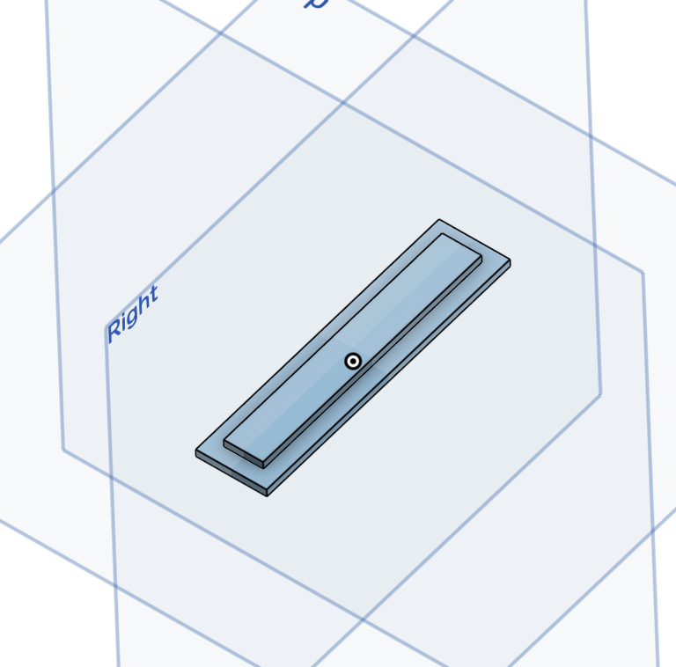
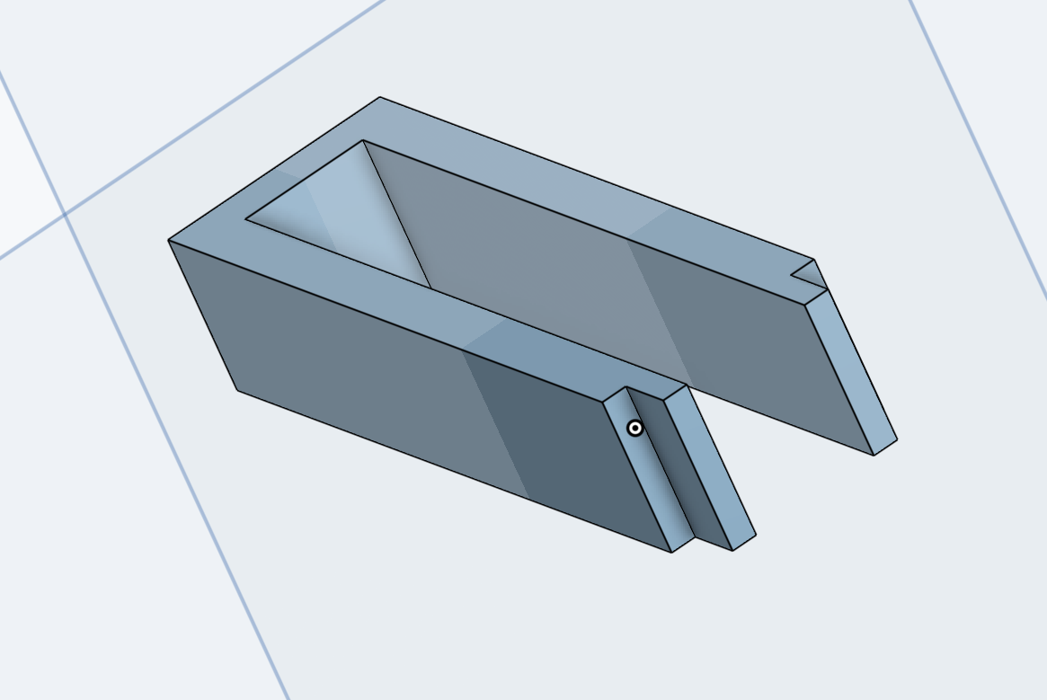
Improved design V3

Slide 20
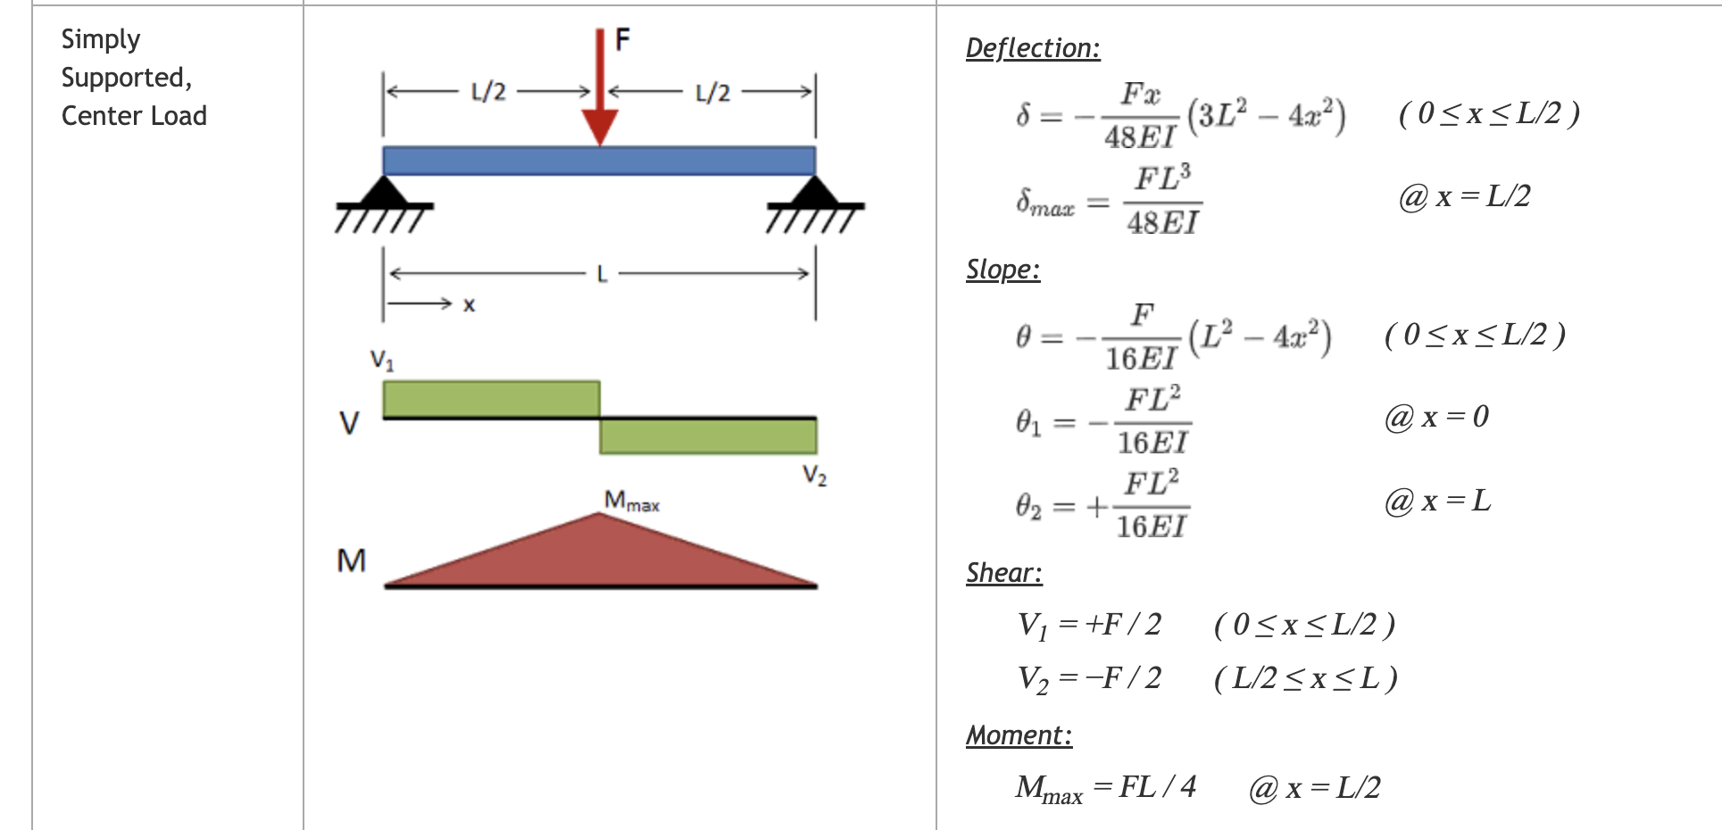
Calculation

Slide 21
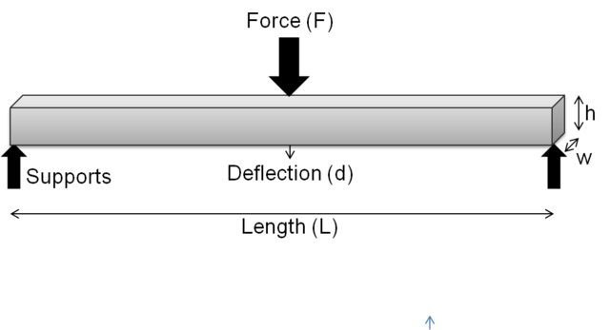
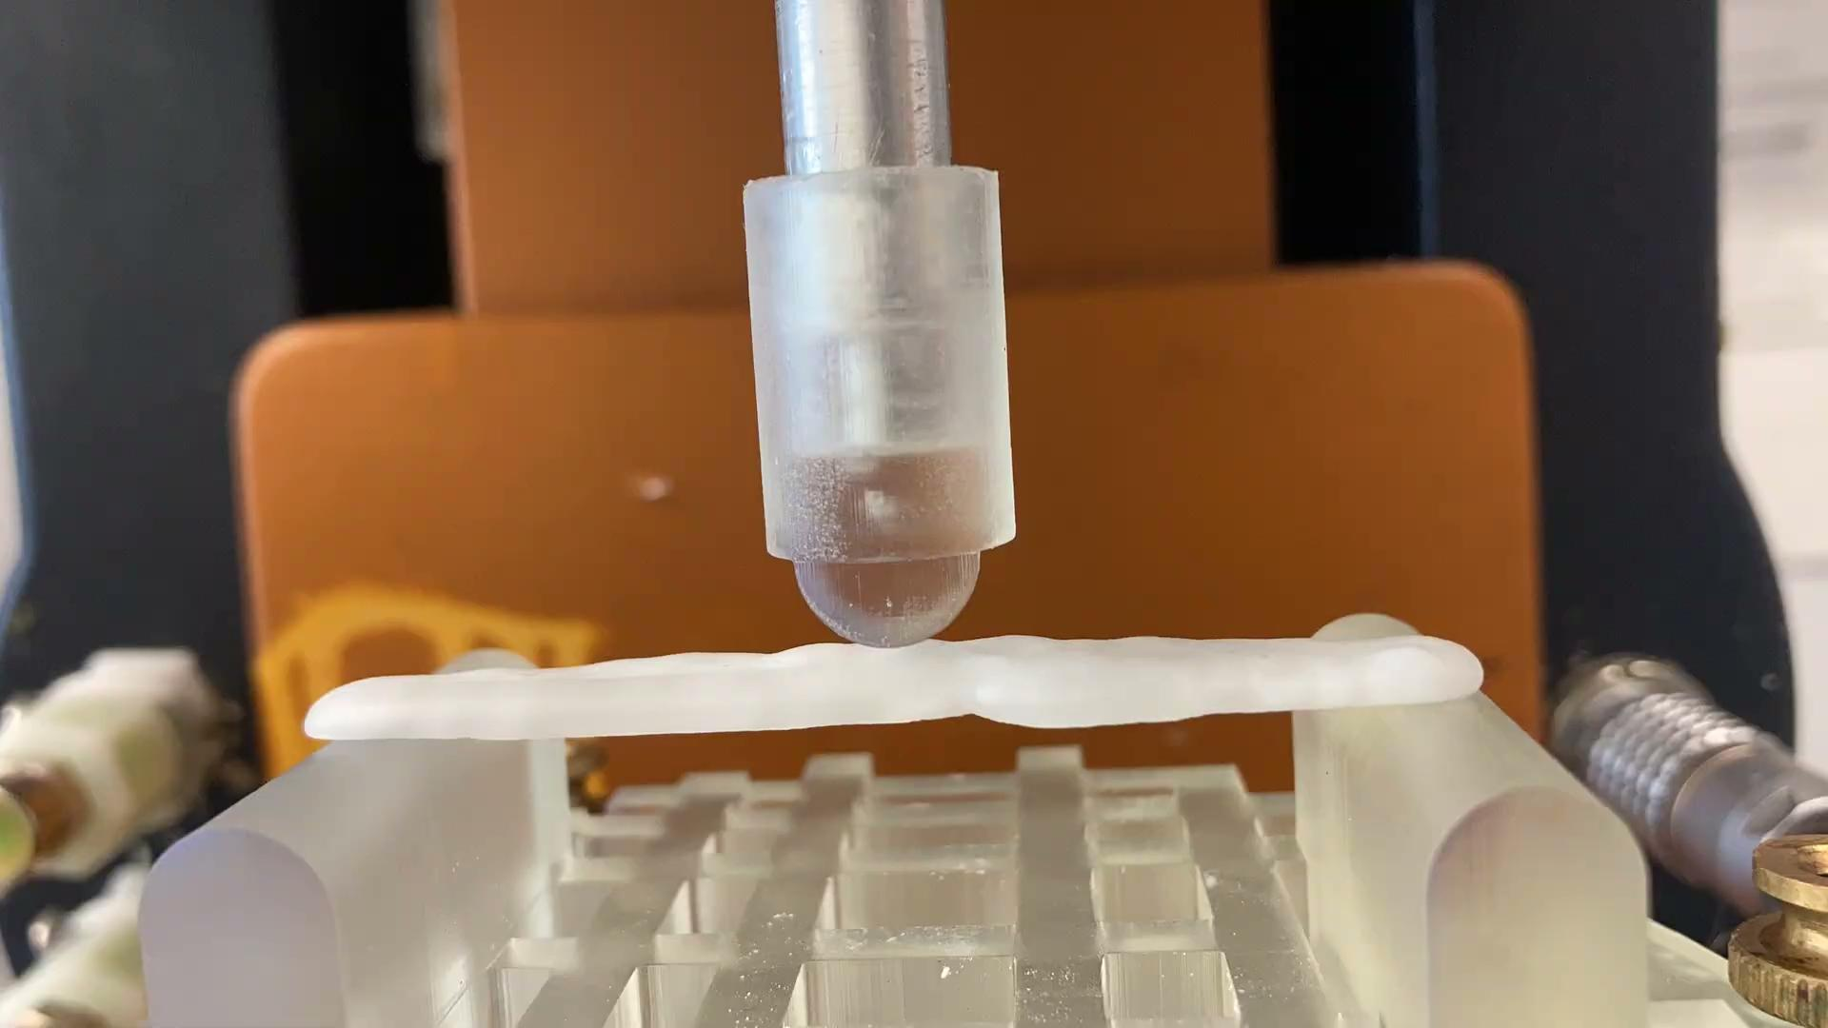
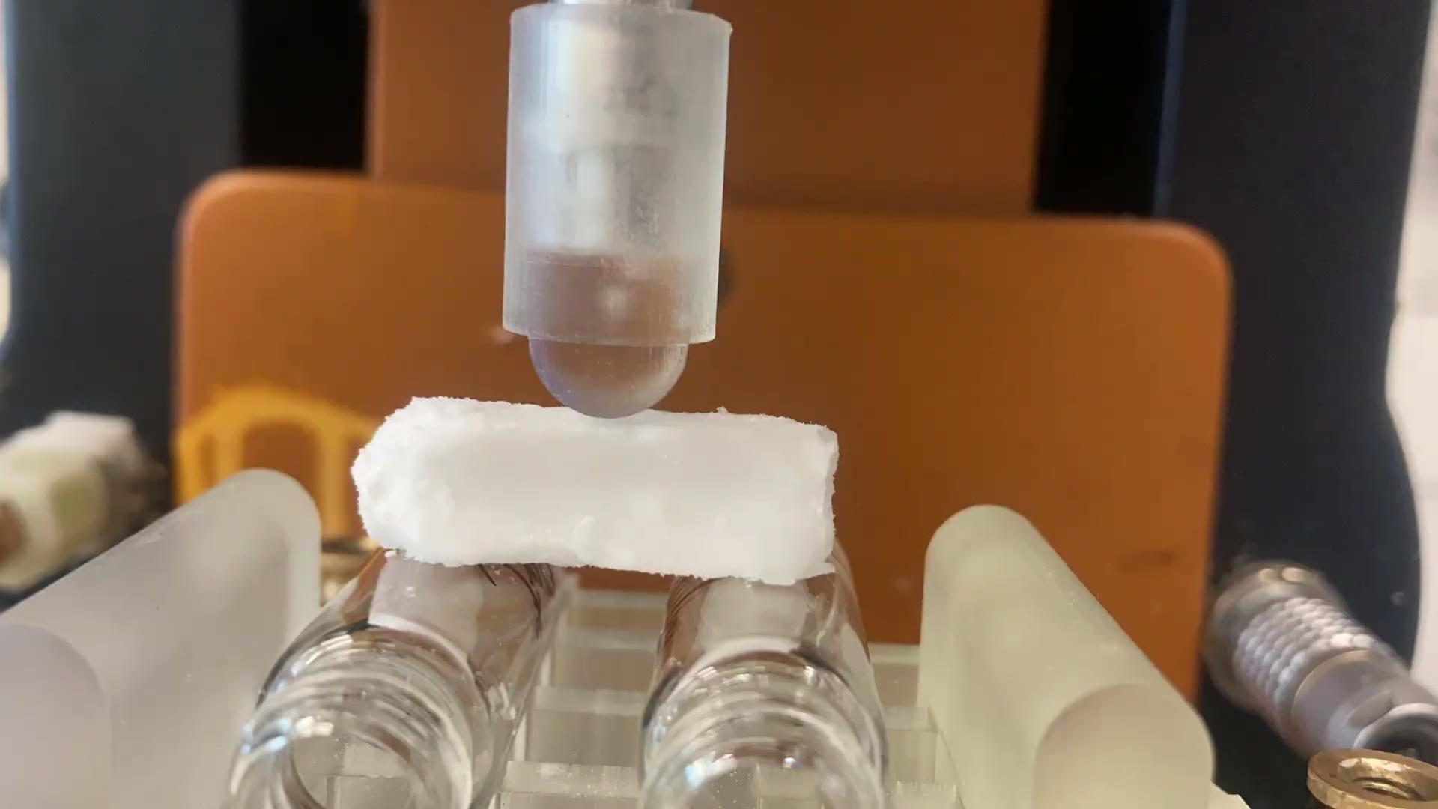
Bending test

Slide 22
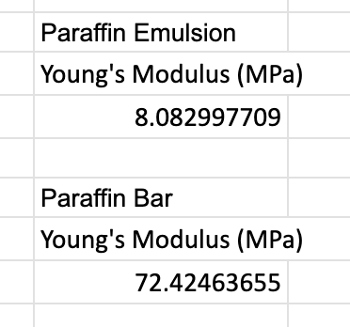
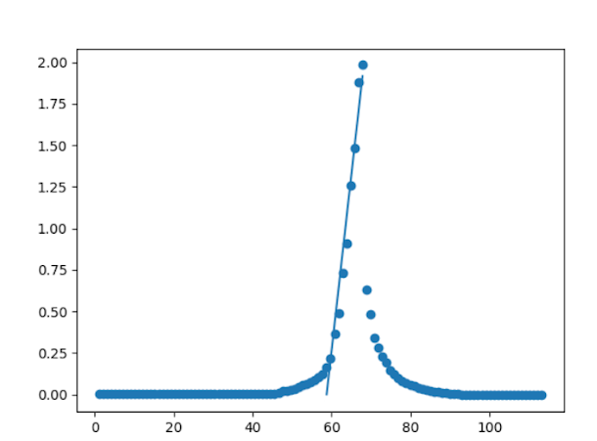
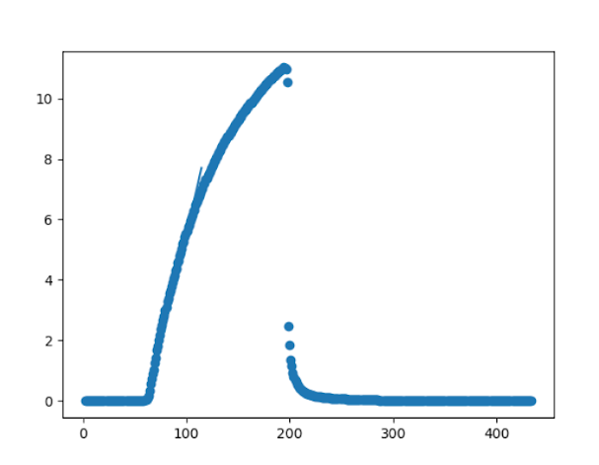
Results (Problems)
Paraffin Emulsion (tensile)
Paraffin Bar (tensile)

Slide 23
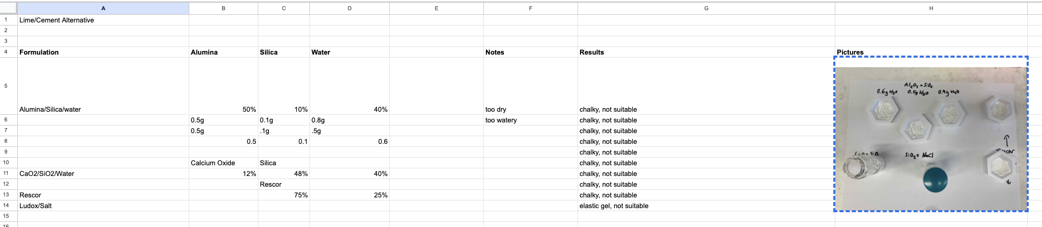
Proof of concept - Cement Emulsions

Slide 24
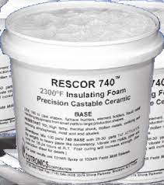
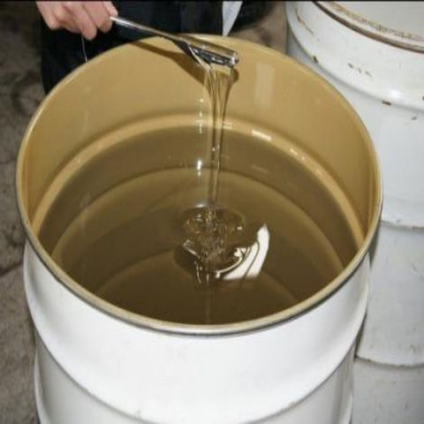
Cement Emulsions

Slide 25
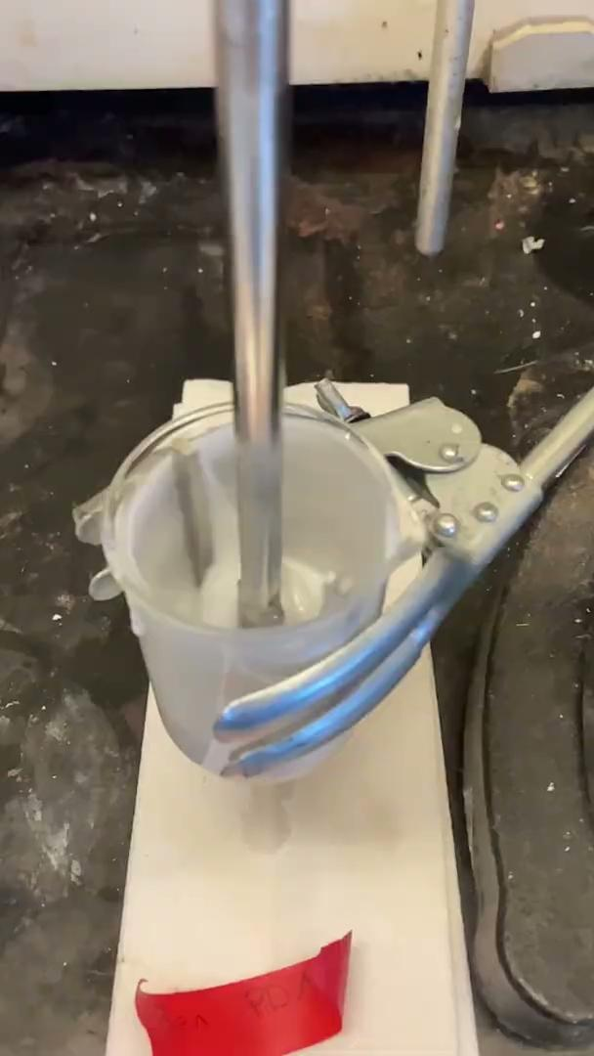
Cement Emulsions

Slide 26
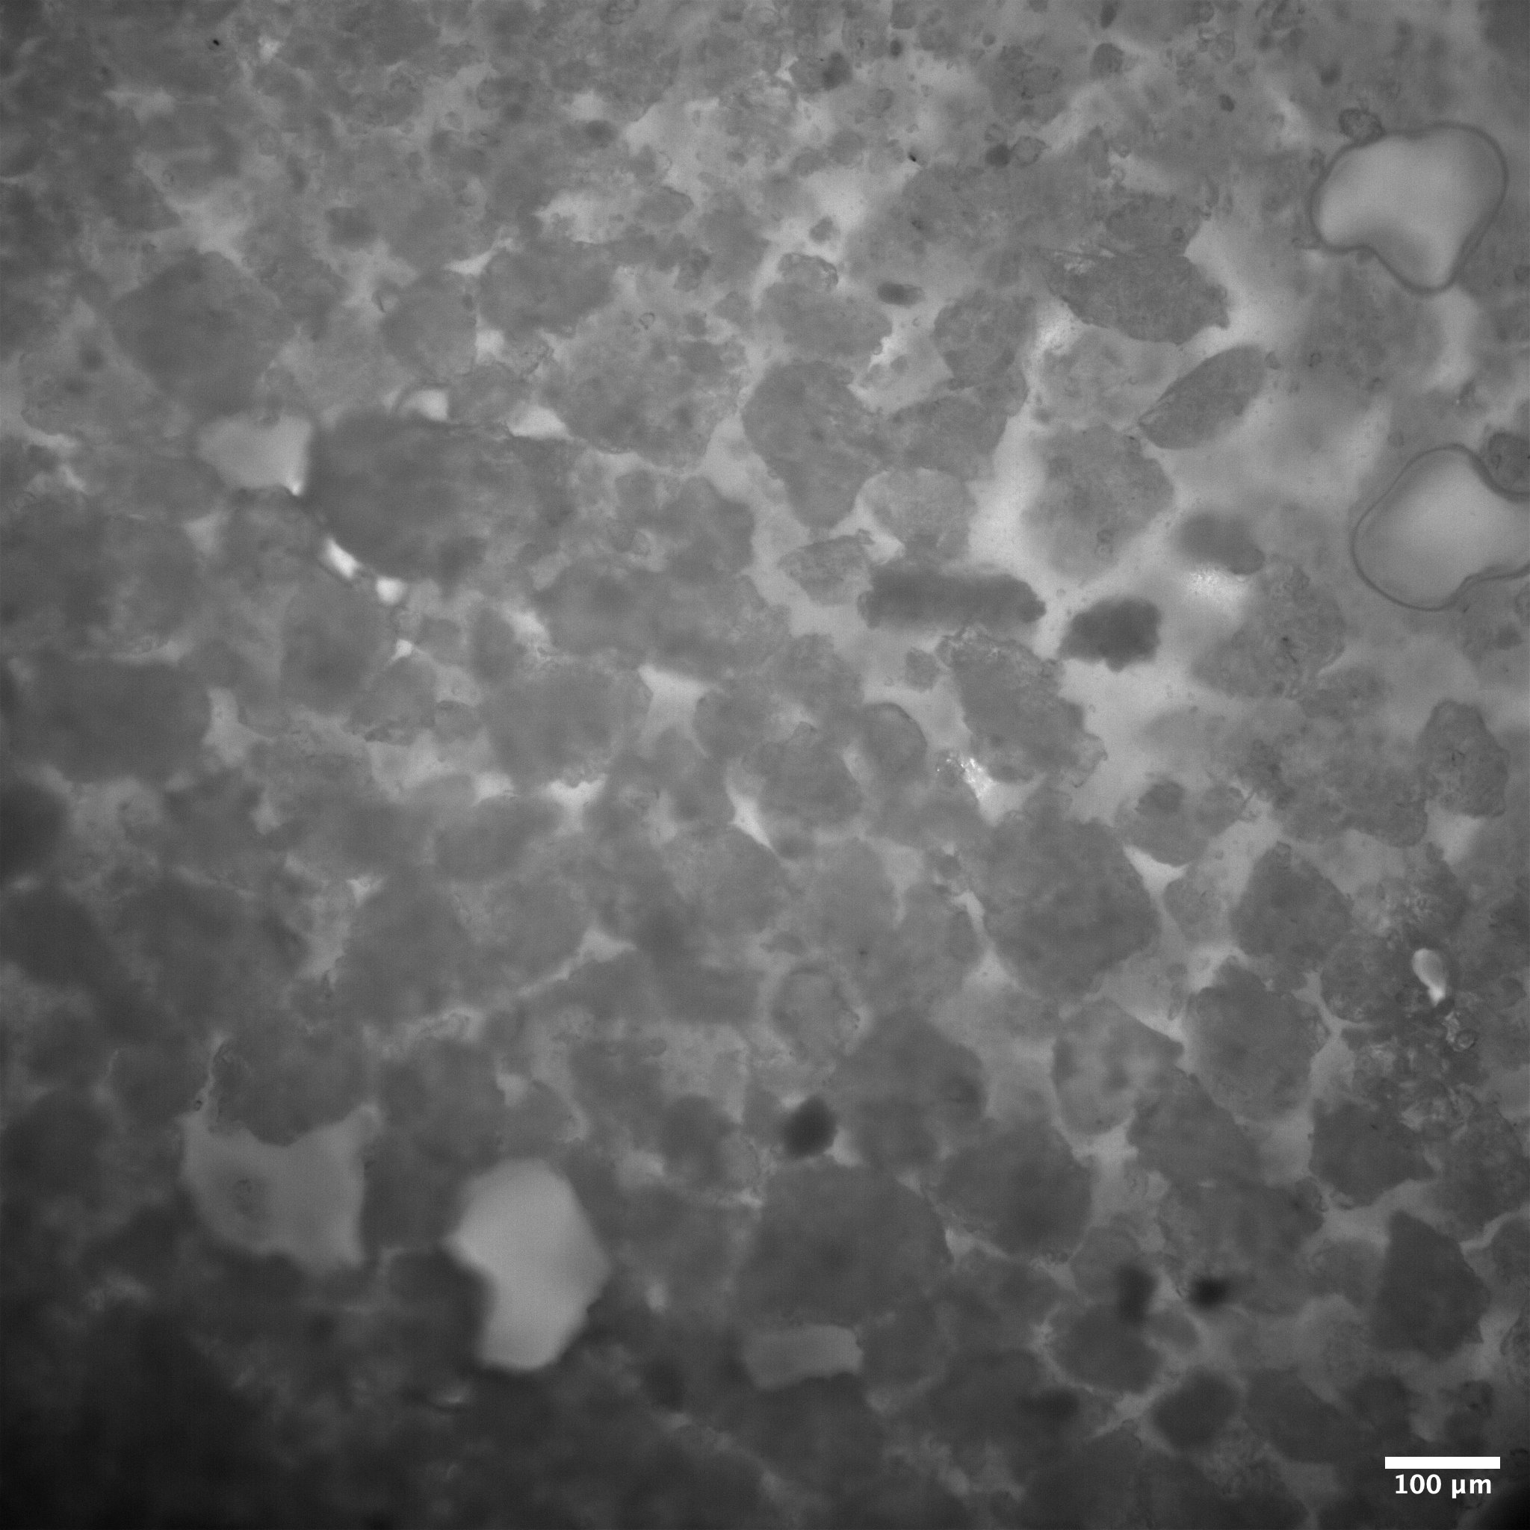
Cement Emulsions
1% Surfactant, Concentrated rescor 780 in PDMS.

Slide 27
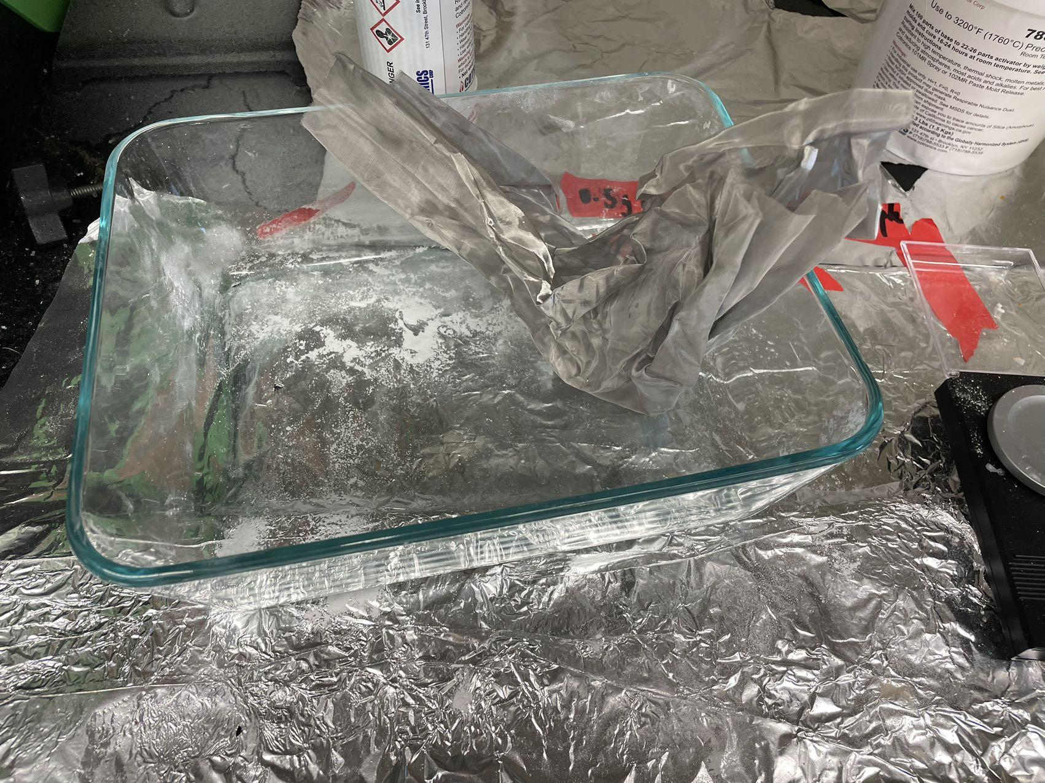
Improvement - finer particles

Slide 28
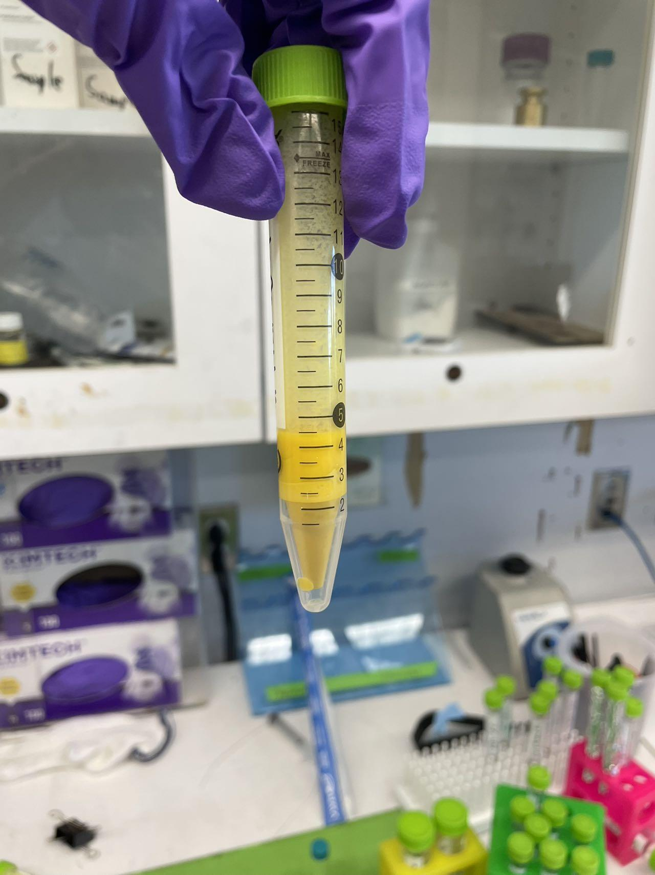
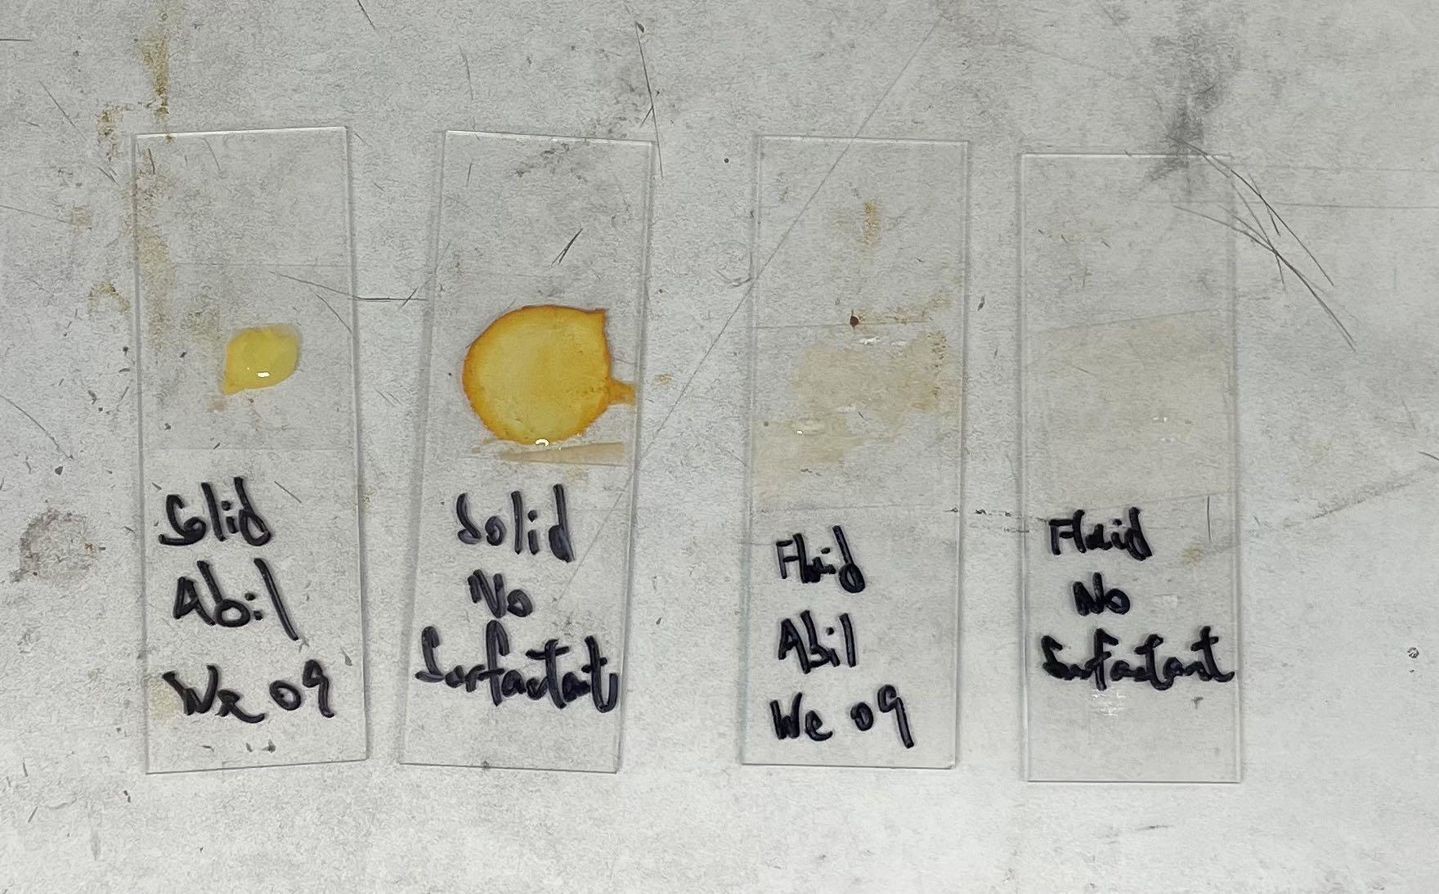
Results

Slide 29
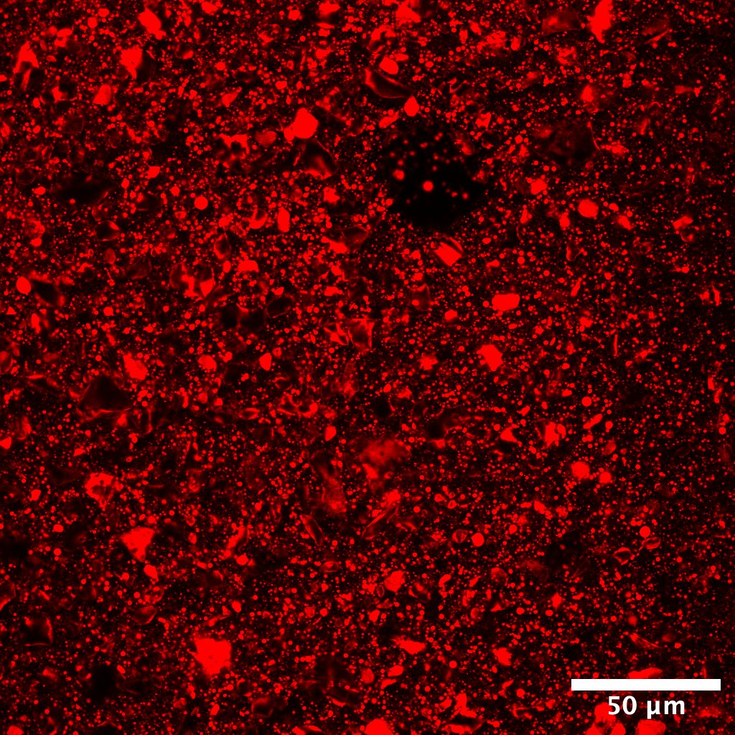
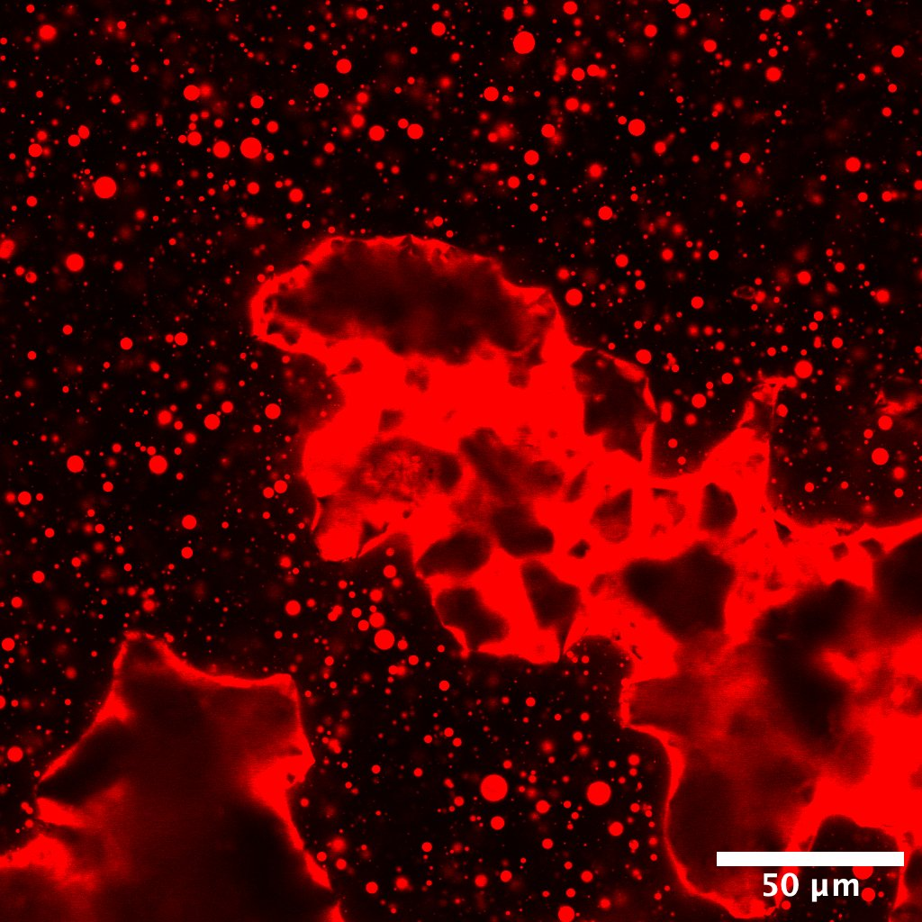
Results - fluorescent cement
0.3% Surfactant
No Surfactant

Slide 30
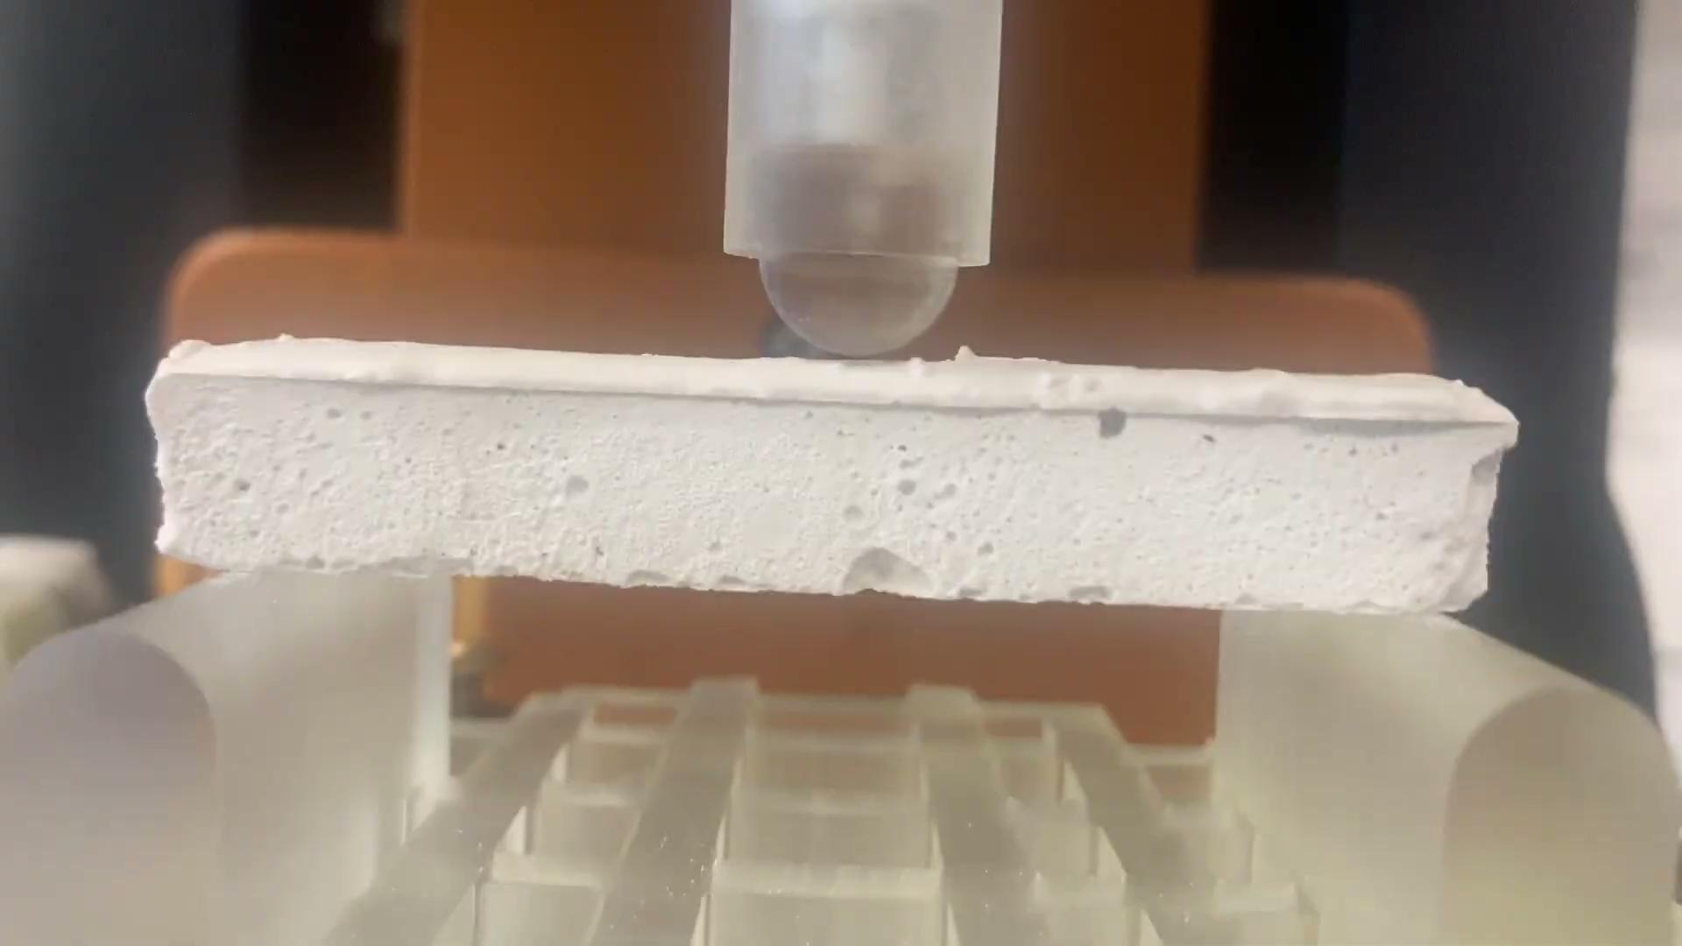

Strength test
Rescor 780
Rescor/PDMS Composite

Slide 31
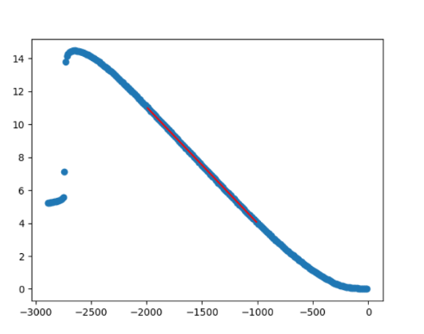
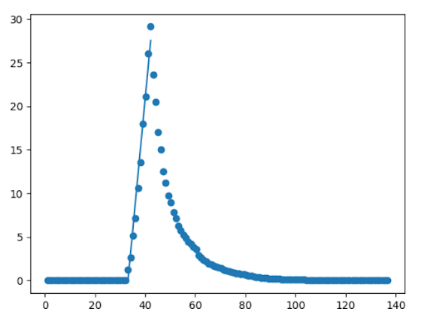
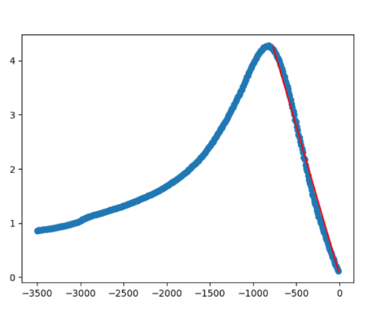
Strength test
Pure PDMS (compression)
Rescor 780 (tensile)
Rescor/PDMS Composite (compression)
E = 2.2 MPa
E = 2.8 GPa
E= 2.3 MPa

Slide 32
What needs work
Possible material replacement
Testing new molds
Continuing the emulsion experiments
New material structure
CAD Models:
https://cad.onshape.com/documents/c70dcdd9a68eff151ea94396/w/0b4fb648c1ffb01c523c78c7/e/a9e01e084043daa1a3dbf910?renderMode=0&uiState=6684cd534cfa295e9f2f780c
Github Repository:
https://github.com/CooperWang0912/Weitz-Lab/tree/main

